Slide 1
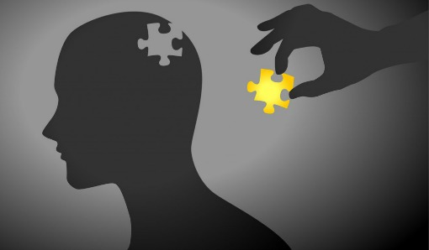
Pro-social behaviour
AEPSY Year 11 ATAR Psychology

Slide 2
Review
List five factors that influence antisocial behaviour.
Define the bystander effect.
Explain the difference between obedience and conformity.
Give examples of situational and dispositional attribution.
According to Festinger, what creates tension within a person that leads to discomfort?
Summarise Bowlby’s maternal deprivation theory, using Genie the Wild Child as an example.

Slide 3
Review
Diffusion of responsibility;Audience inhibition;Social influence;Cost-benefit analysis;Groupthink
More bystanders = less likely to help in an emergency
Obedience has authority/power influencer, who can reward or punish and behaviour is attributed to them
Situational – external factors; Dispositional – internal factors
Festinger: Cognitive Dissonance – mismatch between beliefs and actions
Genie was deprived of care and did not develop cognition, language, fine or gross motor skills.

Slide 4
Learning Intentions
pro-social behaviour in response to social influence
factors influencing pro-social behaviour – reciprocity principle, social responsibility, personal characteristics (empathy, mood, competence), altruism
helping as an example of prosocial behaviour

Slide 5
Success Criteria
Define prosocial behaviour
List four factors influencing prosocial behaviour
Define altruism
Describe helping as an example of prosocial behaviour

Slide 6
Prosocial Behaviour
Voluntary actions that promote social acceptance and benefit society and its members.

Slide 7
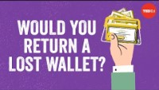

Slide 8
Factors influencing Pro-Social Behaviour
Reciprocity Principle: the social norm where a person feels obligated to return the favour to a person that does something for them.
Reciprocity concerning the exchange of helpful behaviour between people is related to altruism. There is no expectation of a returned favour due to the assumption that the person being helped would do the same for them.

Slide 9
Factors influencing Pro-Social Behaviour
Social responsibility: the theory that individuals are accountable for acting in a way that benefits society.
Individuals with a higher level of social responsibility perform more pro-social behaviours

Slide 10
Personal characteristics
Empathy: the ability to sense and share the thoughts and feelings of another person
Mood: When an individual is in a positive mood, they carry out pro-social behaviours to maintain it (‘feel-good, do-good’
Competence: An individual who believes they have the ability to help others is more likely to do so.

Slide 11
Altruism
Helping others without expecting reward.

Slide 12
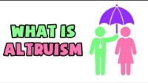

Slide 13

Helping
Voluntary actions that benefit others. Why would you help others?
Evolutionary aspects – helping family strengthens your gene pool
Empathetic or altruistic reasons
Increases positive mood
Expectation of reward (reciprocity)
Taught/reinforced throughout childhood
Social media trend – “Acts of kindness”

Slide 14
Success Criteria
Define prosocial behaviour
List four factors influencing prosocial behaviour
Define altruism
Describe helping as an example of prosocial behaviour

